Slide 1

St. Pete IoT
Brought to you by

Slide 2
St. Pete IoT
Brought to you by
Nicolas Mejia

Slide 3
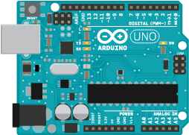
Today’s Agenda
Arduino
Them downloads…
What is Arduino?
What can we do with it?
C and C++
What is C?
Datatypes, Functions n’ stuff…
Embedded Topics
Program Flow
Lets make a program
Image from Arduino.cc

Slide 4
Arduino
Development kit for that contains
Microcontroller
USB connection
Headers for GPIOs

Slide 5
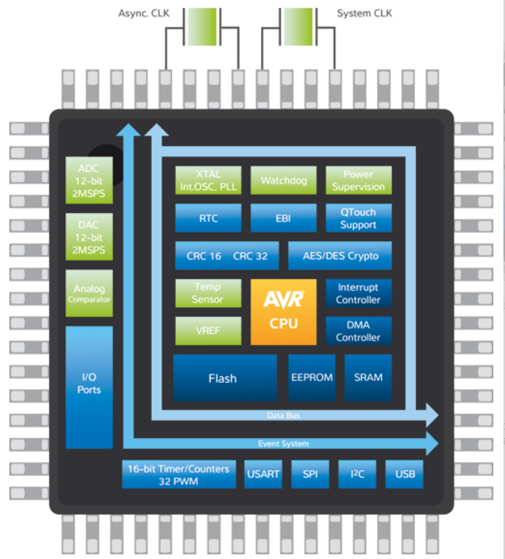
Microcontrollers
Typical Contents
CPU
Memory
Flash
Ram
Peripherals
Image from Atmel.com

Slide 6
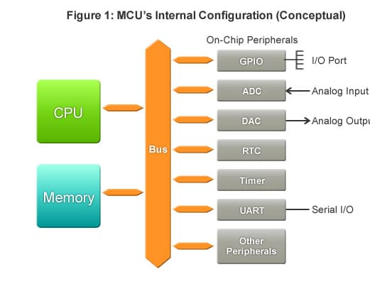
Peripherals
Receive
Send
Process
Image from Renasas.com

Slide 7
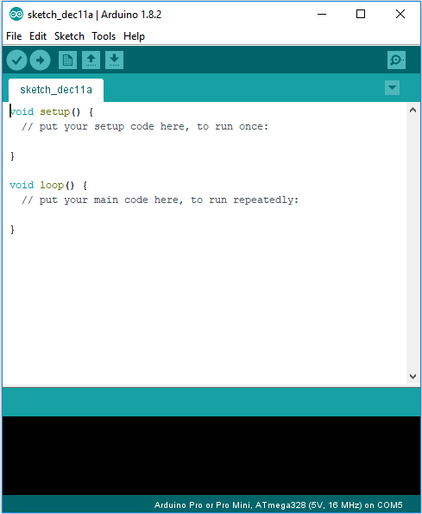
How do we use an Arduino?
C or C++
Arduino IDE is needed

Slide 8
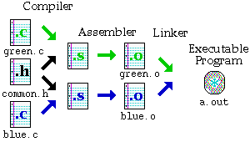
The magic of C programming
Image from Dartmouth.edu

Slide 9
Arduino Flow
SETUP
LOOP

Slide 10
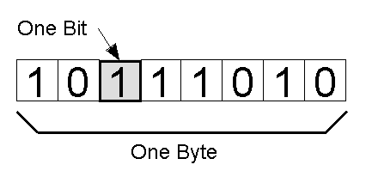
Programming
Data and Datatypes
void
boolean (1 byte)
char (1 byte)
int (2 bytes)
float (4 bytes)
…etc
Find more at https://playground.arduino.cc/Code/DatatypePractices
Image from Quora.com

Slide 11
Programming
Keywords mold the language
setup
loop
int
return
if
switch
break
while
Compiler directives
#define
#include

Slide 12
Programming
Functions = Datatypes + Operations + Other functions(optional)
Functions can return values
int my_function(int a)
{
return a + 1;
}
Functions may be referenced and defined in Libraries (.h files)

Slide 13
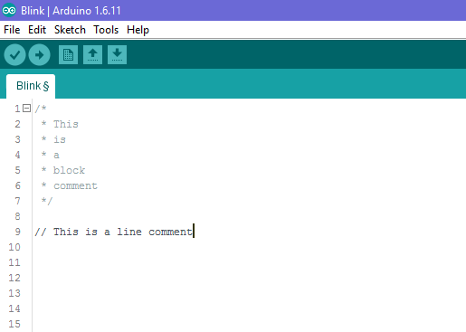
Comments

Slide 14
Setting up the environment
https://www.arduino.cc/en/Main/Software
Download Arduino 1.8.5
If you have windows, download the installer preferably
For Arduino knock offs, you may need these drivers
https://www.silabs.com/products/development-tools/software/usb-to-uart-bridge-vcp-drivers

Slide 15
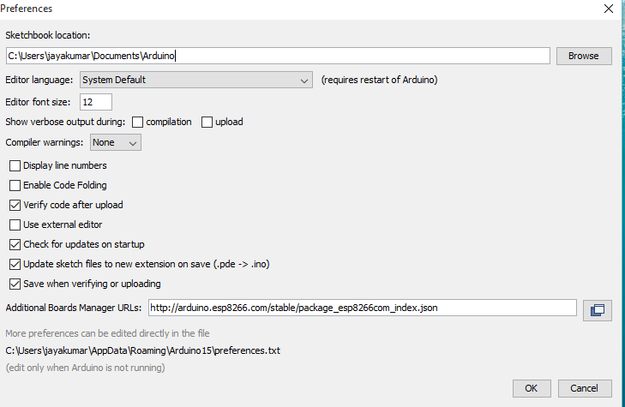
Setting up the environment
Image from https://www.instructables.com/id/Quick-Start-to-Nodemcu-ESP8266-on-Arduino-IDE/

Slide 16
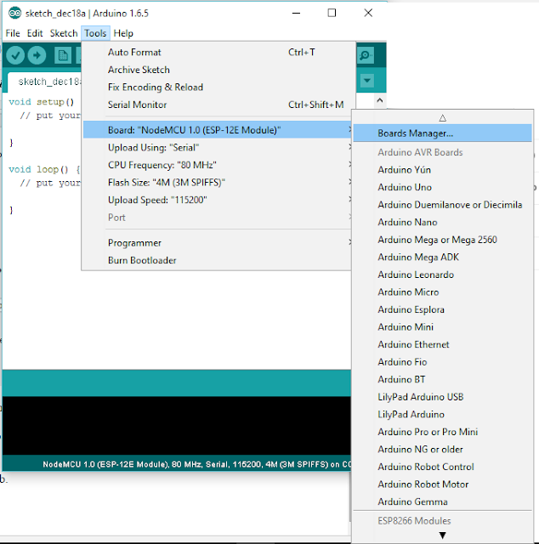
Setting up the environment
Image from https://www.instructables.com/id/Quick-Start-to-Nodemcu-ESP8266-on-Arduino-IDE/

Slide 17
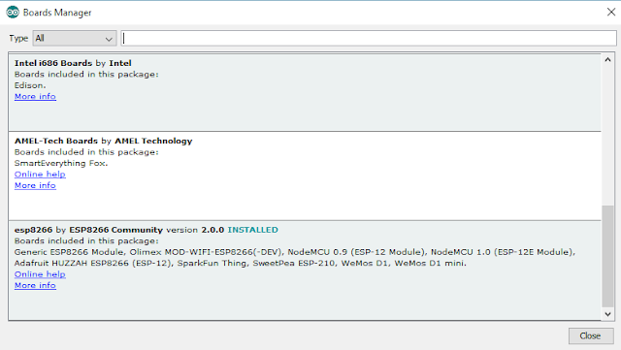
Setting up the environment
Image from https://www.instructables.com/id/Quick-Start-to-Nodemcu-ESP8266-on-Arduino-IDE/

Slide 18
Setting up the environment
esp8266
Image from https://www.instructables.com/id/Quick-Start-to-Nodemcu-ESP8266-on-Arduino-IDE/

Slide 19
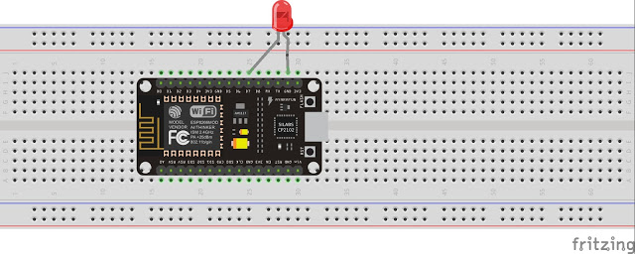
Setting up the environment
Image from https://www.instructables.com/id/Quick-Start-to-Nodemcu-ESP8266-on-Arduino-IDE/

Slide 20
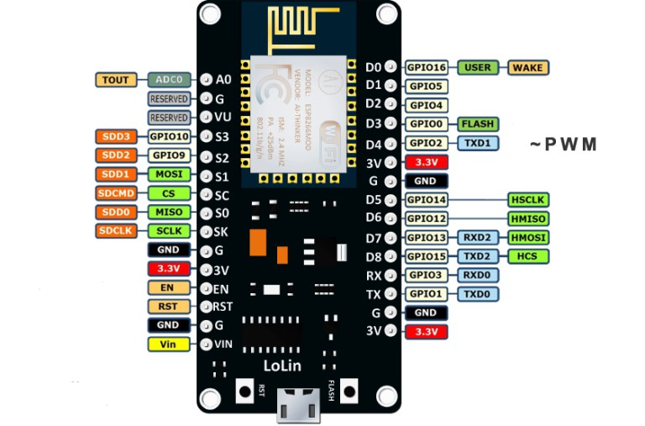
Pinout
Image from https://www.teachmemicro.com/nodemcu-pinout/

Slide 21
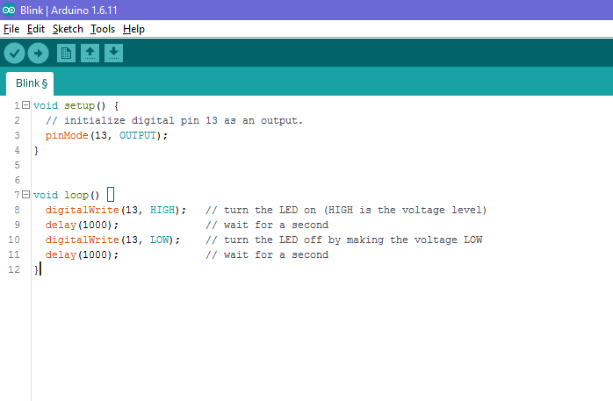

Slide 22


Slide 23
Programming
More information on Arduino API (the set of Arduino-specific programming functions that you can use): https://www.arduino.cc/reference/en/

